Slide 1
Data Structures and Algorithms
Lecture 05

Slide 2
Outlines
Stack
Creating Stack
Push and Pop operation
Dynamic stack

Slide 3
Stack: Introduction
Stack is a data structure that is based on Last In First Out (LIFO) i.e. elements that are inserted first will be removed at the end and the elements that are inserted last will be removed first.
A stack or LIFO (last in, first out) is an abstract data type that serves as a collection of elements, with two principal operations: push, which adds an element to the collection, and pop, which removes the last element that was added.

Slide 4
Stack
Stack operations
push()
Push item to the top of the stack.
Pop()
Pop the top item from the stack.
Top()
Return item at the top without removing/pop it
isEmpty()
Returns true if stack is empty.

Slide 5
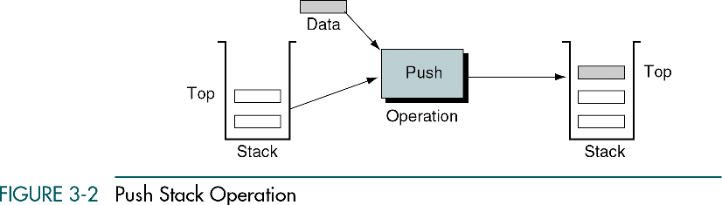
Stack
Push() operation

Slide 6
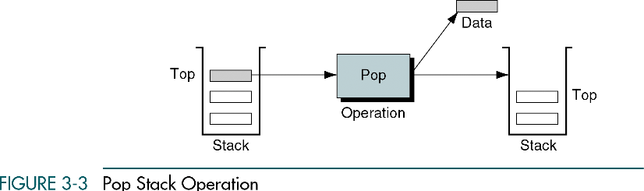
Stack
Pop() operation

Slide 7
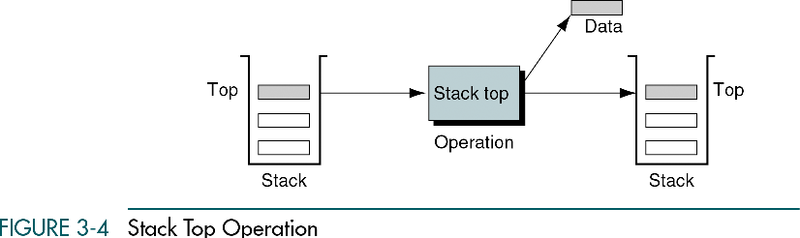
Stack
top() operation

Slide 8
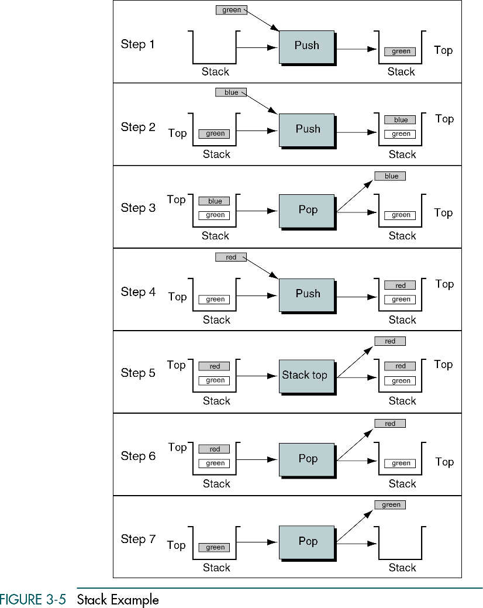
Stack Operations

Slide 9
Stack: Array based Implementation
#include<iostream>
using namespace std;
class Stack{
double* array;
int topIndex;
int size;
public:
Stack (int size) {
double* array=new double[size];
topIndex=0;
}
void push(double val) {
if (topIndex<size) {
array[topIndex]=val;
topIndex++;
}
else {
cout<<"stack is full";
}
}
double pop()
{
if (topIndex>0){
return array[--topIndex];
}
}
double topIndex() {
if (topIndex>0)
return array[topIndex-1];
}
};

Slide 10
Stack: Array based Implementation
#include"stack.h"
#include<conio.h>
void main()
{
Stack s(3);
s.push(20);
s.push(30);
s.push(40);
s.push(50);
s.push(20);
_getch();
cout<<s.top()<<endl;
cout<<s.top()<<endl;
cout<<s.pop()<<endl;
cout<<s.pop()<<endl;
cout<<s.pop()<<endl;
cout<<s.pop()<<endl;
cout<<s.pop()<<endl;
cout<<s.pop()<<endl;
_getch();
}

